Slide 1
Hamoye Open Source Project 18
Crimes Unemployment

Slide 2
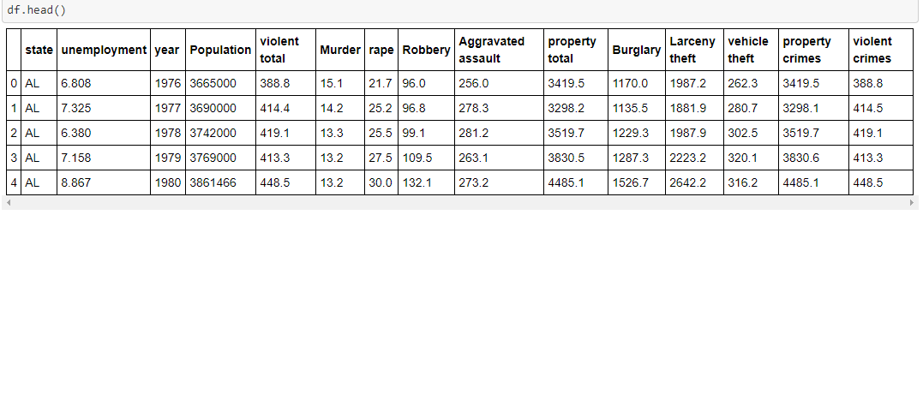
Dataset
The project dataset contains data on various crimes collected over a period of 39 years, from 1976 to 2014 across all 51 states in the United States of America. It consists of 1989 rows and 14 columns

Slide 3
Problem Statement
Will a rise or decline in unemployment cause a corresponding rise or decline in number of (violent) crimes reported?

Slide 4
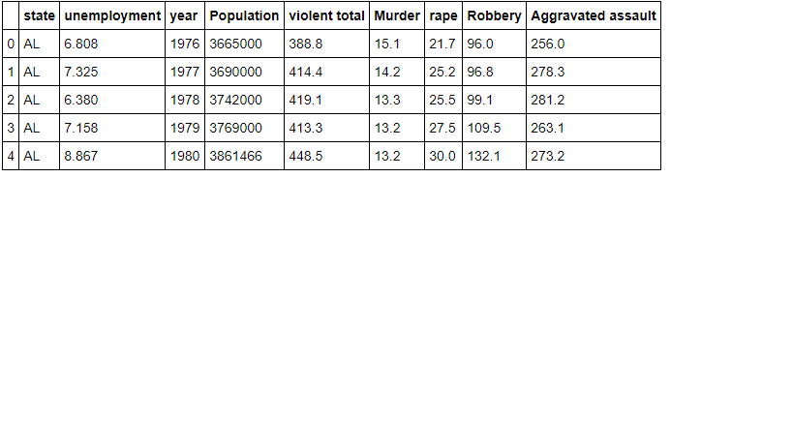
Violent Crimes
Violent crimes consists only of crimes involving any or all of Rape or Murder, Robbery or Aggravated assault

Slide 5
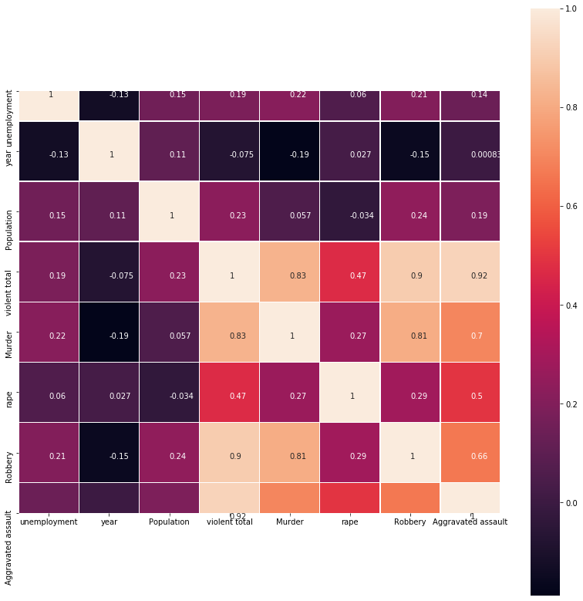
Violent Crimes VS Unemployment Correlation plot

Slide 6
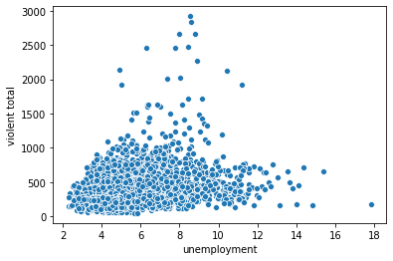
18 % correlation between violent crimes and unemployment

Slide 7
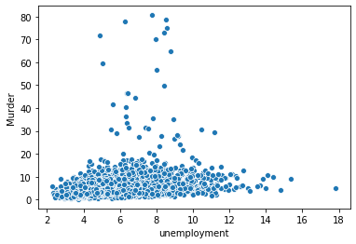
21% correlation between Murder and Unemployment

Slide 8
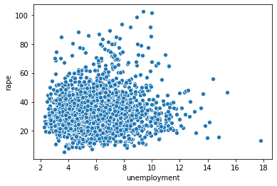
6% Correlation between Rape and Unemployment

Slide 9
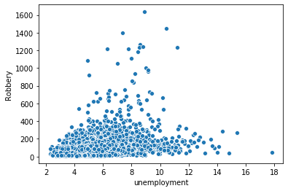
20.5% correlation between Robbery and Unemployment

Slide 10
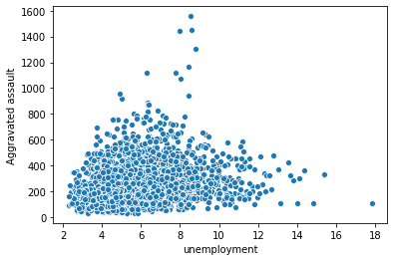
13.9% correlation between aggravated assault and Unemployment

Slide 11
Weak correlations
The scatter plots and correlation coefficients show very weak correlations between unemployment and crime.

Slide 12
A Closer look
Let's pick a few years at random and loot at the relationship between crime and unemployment in those years

Slide 13
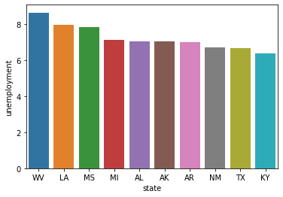
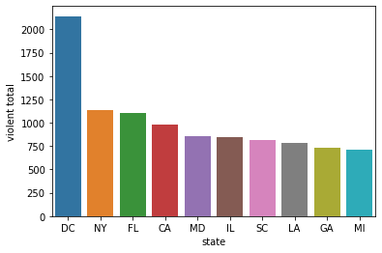
1989 For the year 1989, WV(West Virginia ), which is the state with the highest unemployment rate, does not appear in the top 10 states in violence. DC(Washington DC ), however, which is not in the top 10 unemployment rank, comes first in violence

Slide 14
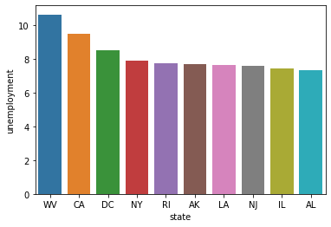
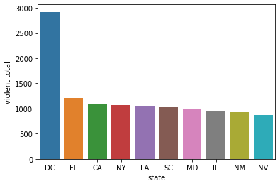
1993 For 1993, again, WV (West Virginia) has the highest unemployment rate, but is not in the top 10 in violence rates. However, DC (Washington DC ), NY(New York), CA(California), LA (Louisiana) and IL(Illinois) all appear in top 10 unemployment and violence rates. But we can't conclude that unemployment is the cause of high violence rates in these states as the correlation between unemployment and crimes is still weak(about 0.457)

Slide 15
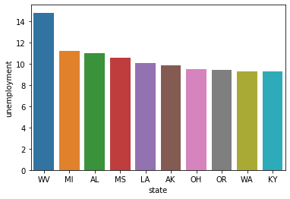
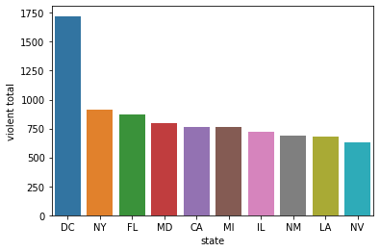
1984 For 1984, apart from LA(Louisiana) which is the 5th highest in unemployment and 9th highest in violent crimes, every other state in the top 10 unemployment plot, do not appear in the violent total plot. Interestingly, WV (West Virginia) again, just like the other years we have explored ranks highest in unemployment, but does not fall into top 10 in violence. DC(Washington DC) on the other hand, just like other years e have explored comes top in violence, but it's not in top 10 of the unemployment plot

Slide 16
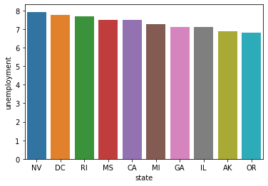
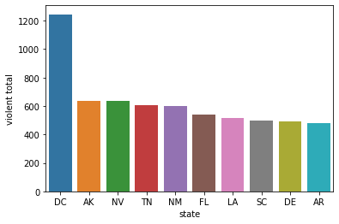
2014 For 2014, DC (Washington DC) is 2nd highest in unemployment, and highest in violence. Every other state in top 10 unemployment does not appear in top 10 violence

Slide 17
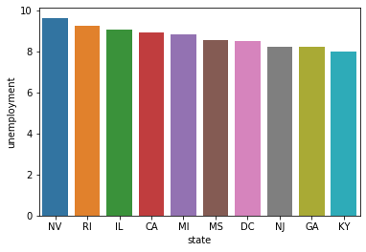
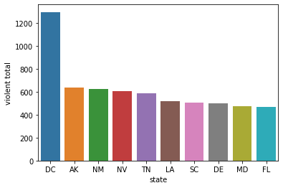
2013 For 2013, NV (Nevada) is the state with the highest unemployment rate, and 4th highest violence rate. DC(Washington DC) is the highest in violence crimes and the 7th highest in unemployment. A closer look at these 2 states shows no correlation between crime and unemployment

Slide 18
Summary
A detailed exploration of the dataset shows very weak correlations unemployment and violent crimes. So we can conclude that a rise or decline in unemployment does not cause a rise or decline in violent crimes.

